Slide 1


JAVASCRIPT

Slide 2
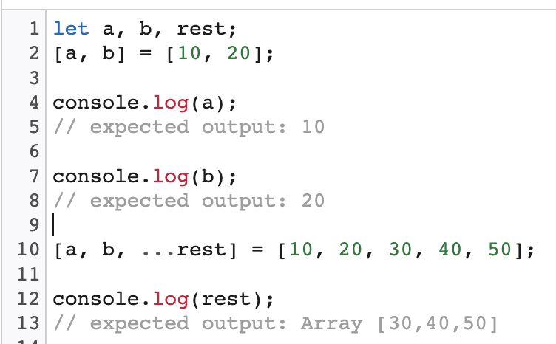
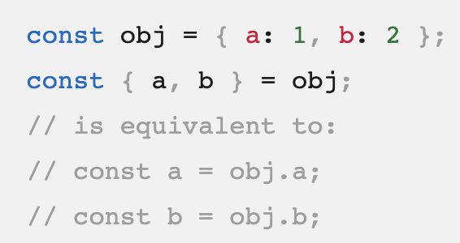
Destructuring assignment
The destructuring assignment syntax is a JavaScript expression that makes
it possible to unpack values from arrays, or properties from objects, into distinct variables.

Slide 3

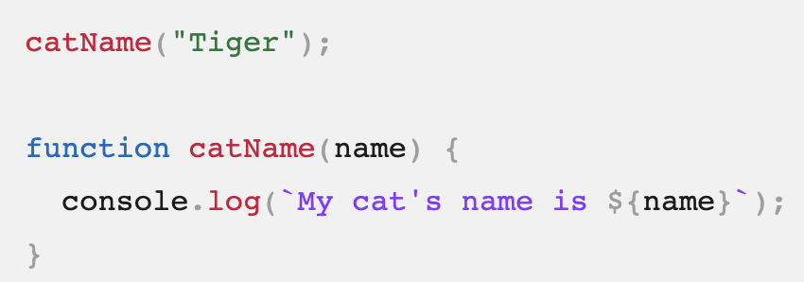
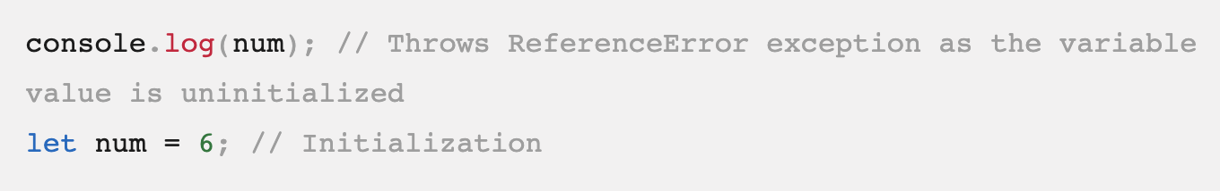

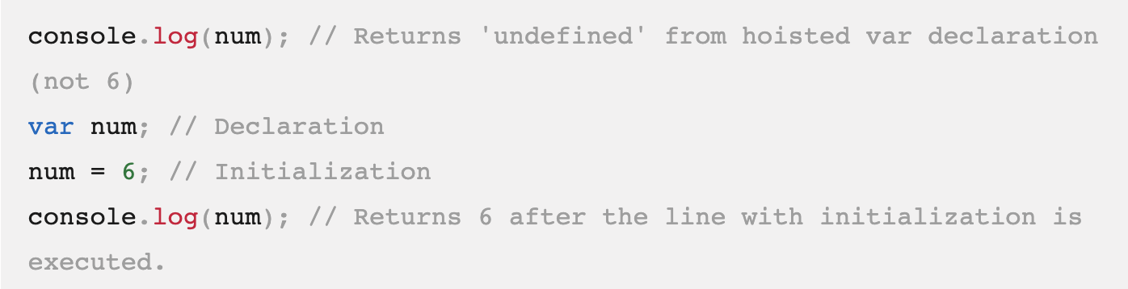
Hoisting in JS
Functions

Slide 4
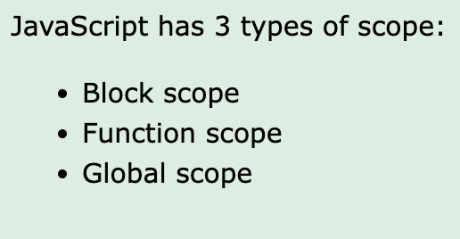
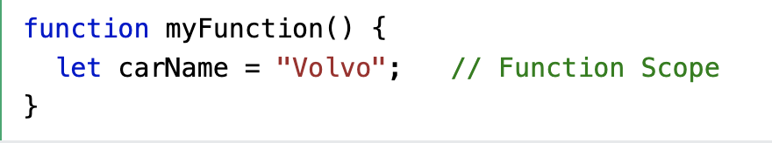
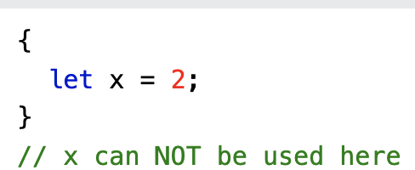
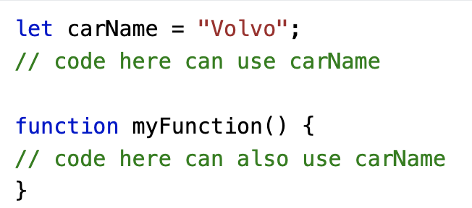
JS Scopes
Block Scope
Global JavaScript Variables

Slide 5
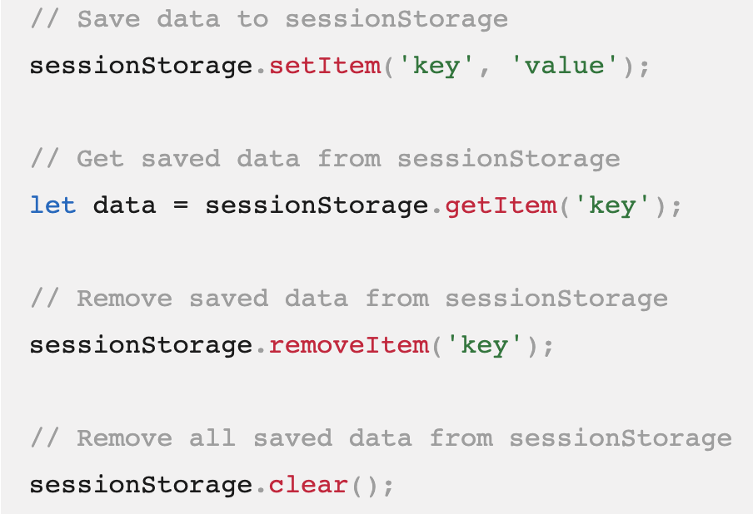
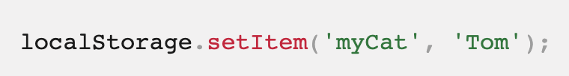
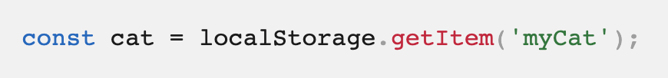


Browser Storage
Types of browser storage
Cookies.
Local storage.
Session storage.
IndexedDB.
Web SQL.
Cache storage.
Session Storage
Local Storage

Slide 6
Tasks
https://stujo-tic-tac-toe-stujo-v1.p.rapidapi.com/XXX------/X Tic Tac Toe suggestions
https://api.agify.io?name=bella
https://api.genderize.io?name=scott
https://api.nationalize.io?name=michael
Show Currencies on Select list where option value must be a currency code
https://api.coinbase.com/v2/currencies.
Google Translate
https://rapidapi.com/googlecloud/api/google-translate1/

